Slide 1
3D Radiomics Analysis of Lung CT Images Using the LIDC-IDRI Dataset
Brieleigh Wescott • 08/15/2026

Slide 2

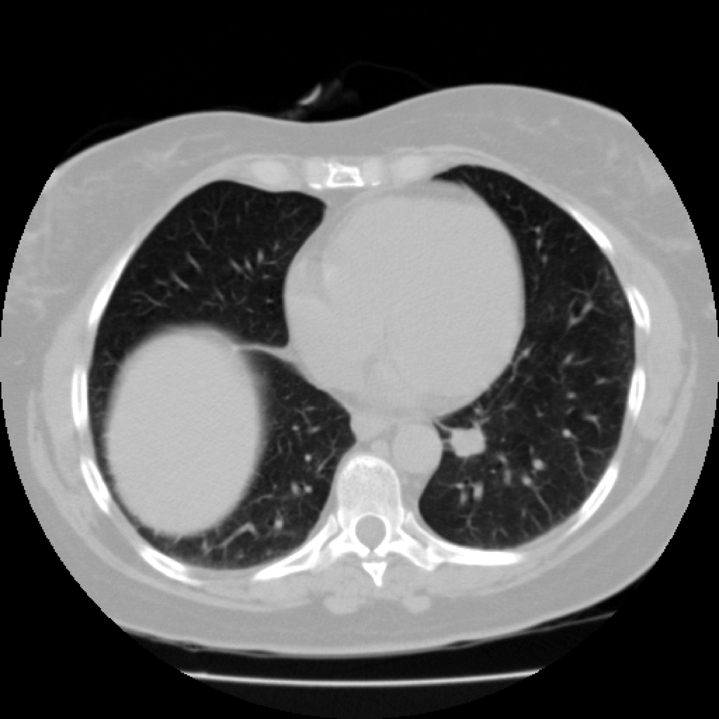
About LIDC-IDRI
Include
1,018 patients
Thoracic CT scans
Over 6,800 radiologist annotations
Up to four thoracic radiologists reviewed each scan
Multiple ratings describing each nodule
Publicly available through TCIA
07/30/2026
Brieleigh Wescott
(Slide No.) ‹#›

Slide 3
Dataset Structure and Download Pipeline
Structure
Download Pipeline
Patient —|
├── Tumor 1
│
├── Tumor 2
│
└── Tumor 3
One patient ≠ One tumor
Our Dataset= One row per tumor
TCIA
↓
NBIA Downloader
↓
244,000+ DICOM files
↓
PyLIDC
↓
Annotated tumors
07/30/2026
Brieleigh Wescott
(Slide No.) ‹#›

Slide 4
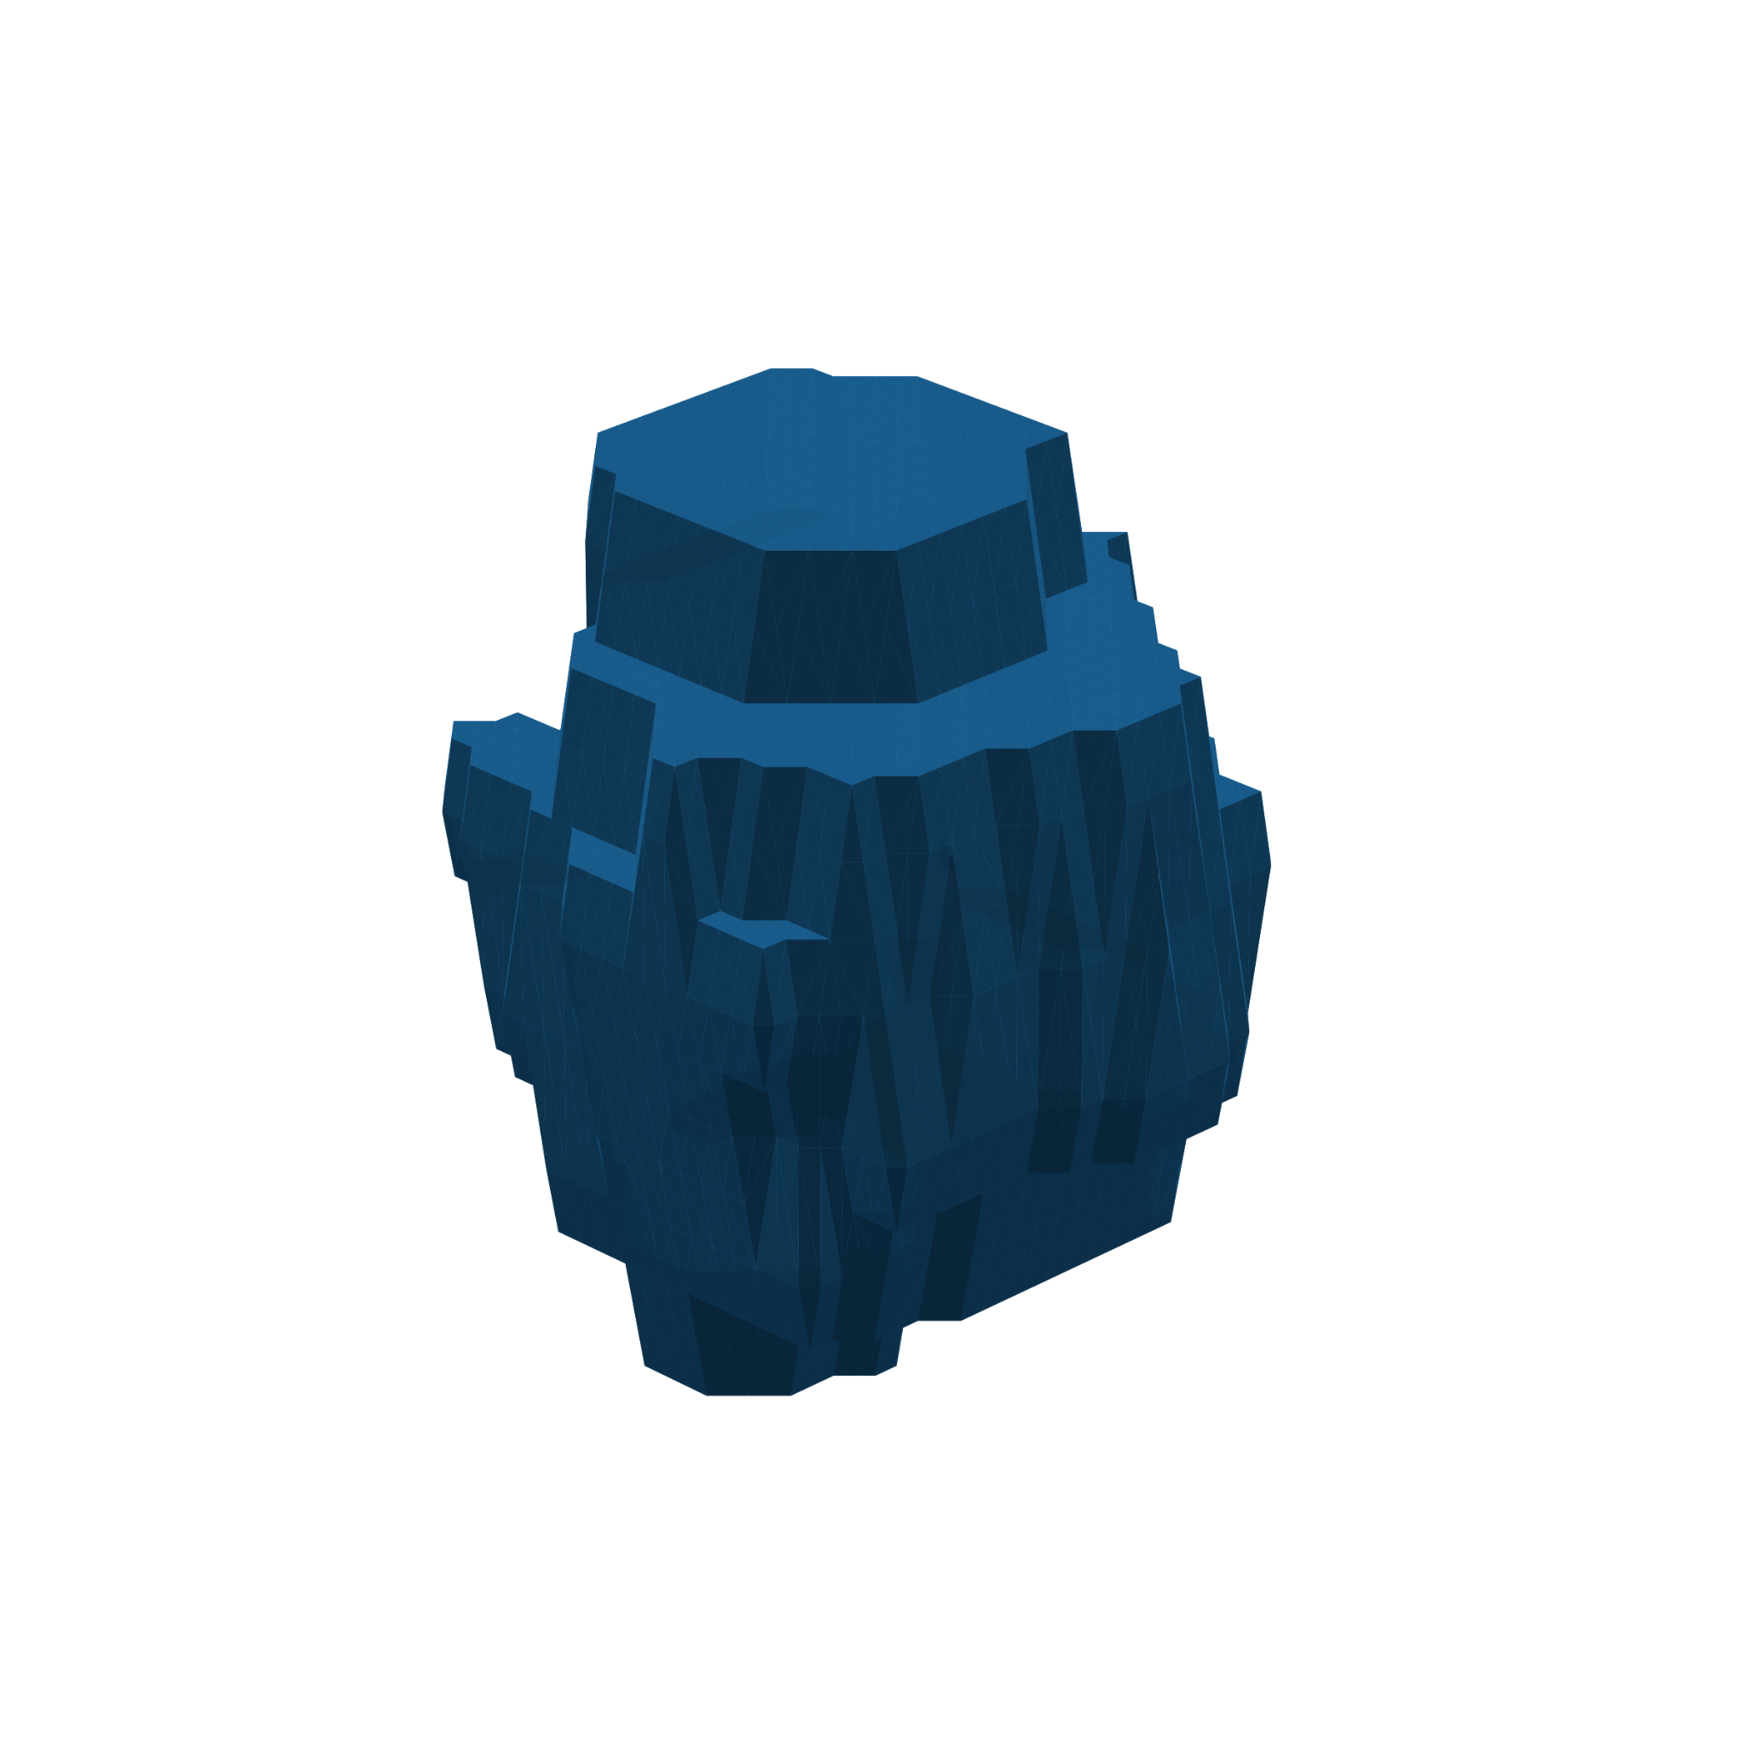
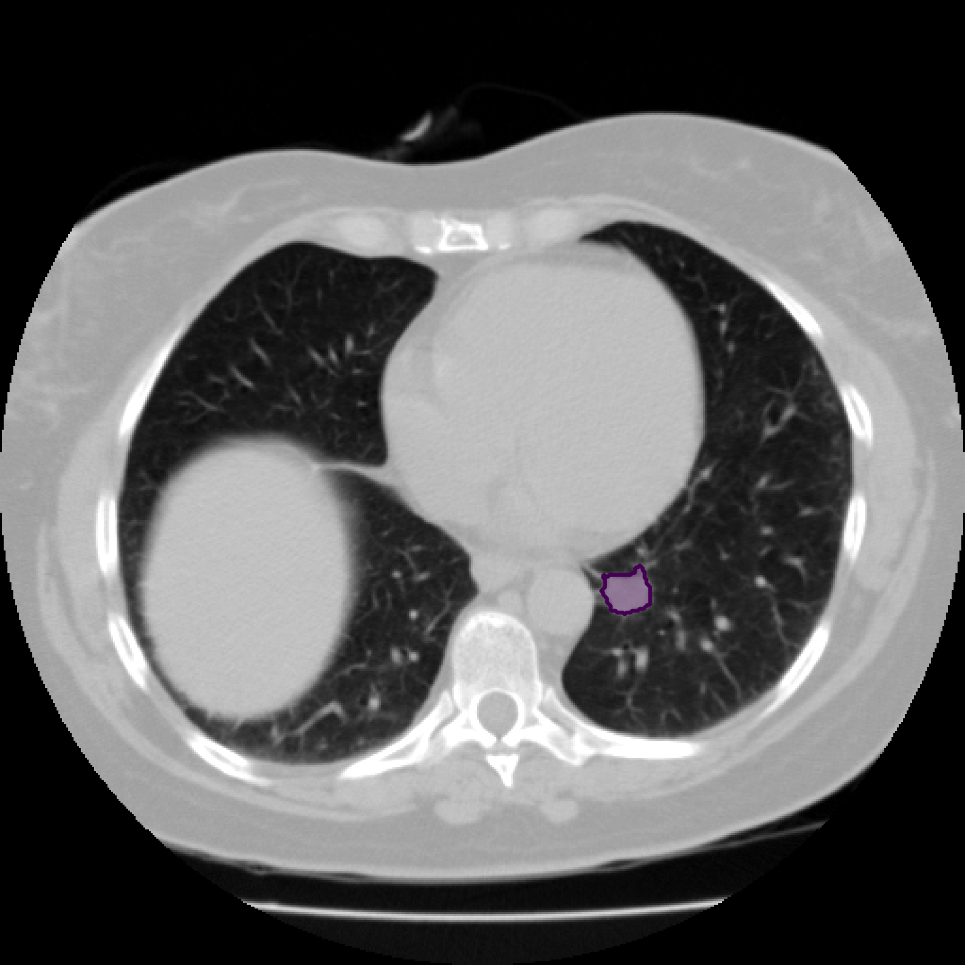
Building 3D Tumors
Workflow
Load the complete CT scan
Group annotations belonging to the same nodule
Generate a consensus segmentation from multiple radiologists
Create one 3D tumor mask
Convert the CT volume and mask to NIfTI format
07/30/2026
Brieleigh Wescott
(Slide No.) ‹#›

Slide 5
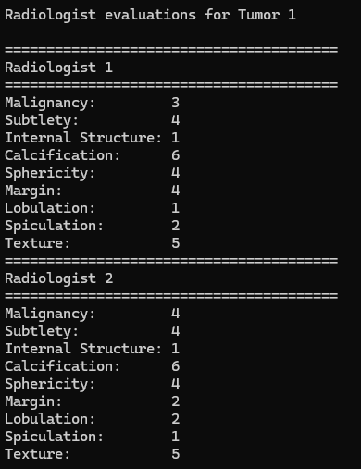
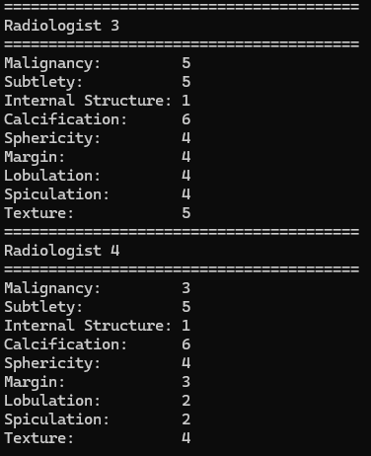
Metadata/ Radiologist Annotations
07/30/2026
Brieleigh Wescott
(Slide No.) ‹#›

Slide 6
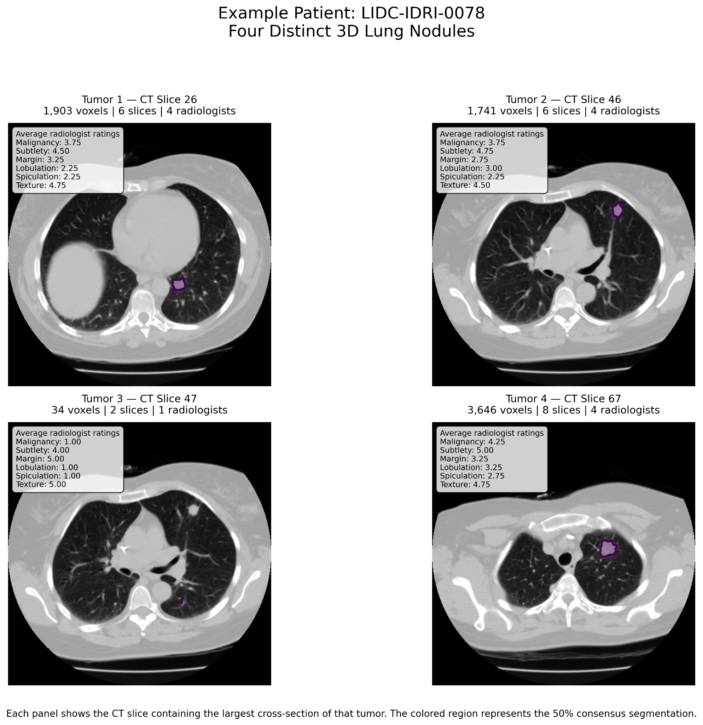
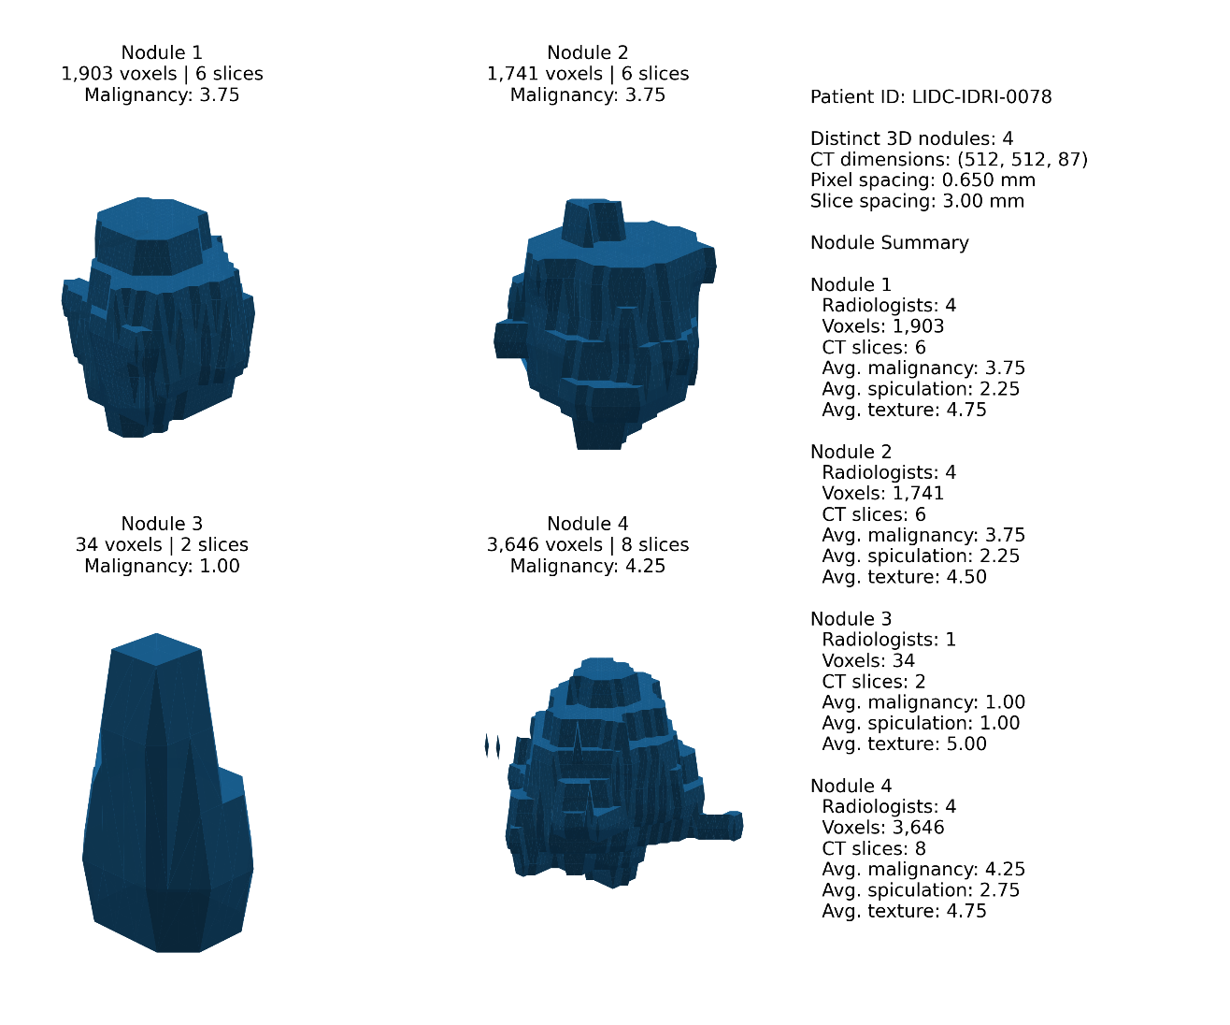
07/30/2026
Brieleigh Wescott
(Slide No.) ‹#›

Slide 7
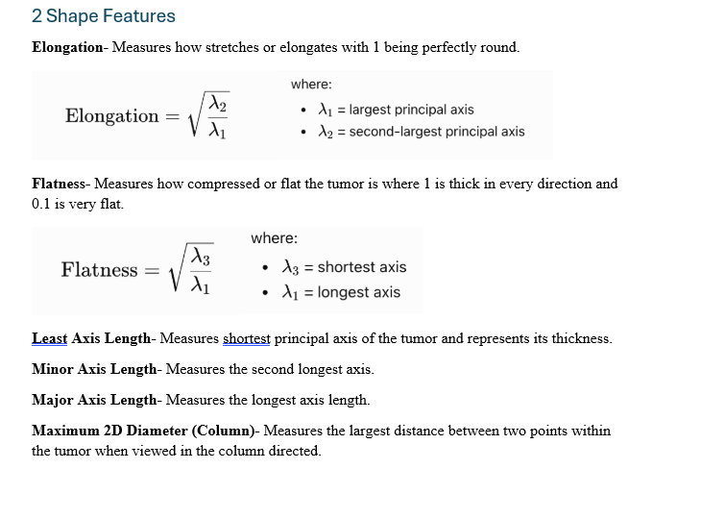
Shape Features
Feature | What it Measures
Volume | Total size of the tumor (mm³)
Surface Area | Total outer surface of the tumor (mm²)
Maximum 3D Diameter | Longest distance across the tumor
Sphericity | How closely the tumor resembles a sphere (0–1)
Elongation | How stretched the tumor is
Flatness | How compressed or flattened the tumor is
Surface-to-Volume Ratio | Surface complexity relative to tumor size
07/30/2026
Brieleigh Wescott
(Slide No.) ‹#›

Slide 8
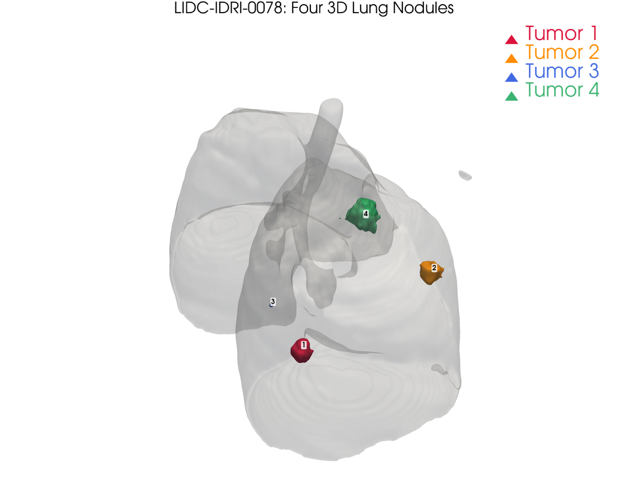
Future Goals
Changing Column Names
Radiomics Document
Organize Dataset
Start Exploring trends and more visualizations
07/30/2026
Footer Space
(Slide No.) ‹#›

